Slide 2
Binghamton University
EngiNet™
State University of New York

Slide 3
Thomas J. Watson
School of Engineering and Applied Science

Slide 4
WARNING
All rights reserved. No part of the course materials used in the instruction of this course may be reproduced in any form or by any electronic or mechanical means, including the use of information storage and retrieval systems, without written approval from the copyright owner.
©2017 International Business Machines Binghamton University

Slide 5
CS580Z
(Fall, 2017)
(Tuesday’s and Thursday’s 11:40 to 1:05)
Introduction to the Mainframe: z/VM Basics
Class 13
October 10th, 2017
Faculty : Merwyn Jones , Melissa Carlson, Doug Breneman
IBM z/VM Lab Development team
( http://www.vm.ibm.com/ )

Slide 6
Trademarks
The following are trademarks of the International Business Machines Corporation in the United States and/or other countries.
DB2
DS8000*
Enterprise Storage Server*
IBM*
IBM eServer
IBM logo*
System Storage*
System z
System z9
System z10
z9*
z10
z/OS*
z/VM
z/VSE
zSeries*
* Registered trademarks of IBM Corporation
The following are trademarks or registered trademarks of other companies.
Intel is a trademark of Intel Corporation in the United States, other countries, or both.
Java and all Java-related trademarks and logos are trademarks of Sun Microsystems, Inc., in the United States and other countries
Linux is a registered trademark of Linus Torvalds in the United States, other countries, or both.
UNIX is a registered trademark of The Open Group in the United States and other countries.
Microsoft, Windows and Windows NT are registered trademarks of Microsoft Corporation.
Red Hat, the Red Hat "Shadow Man" logo, and all Red Hat-based trademarks and logos are trademarks or registered trademarks of Red Hat, Inc., in the United States and other countries.
* All other products may be trademarks or registered trademarks of their respective companies.
Notes:
Performance is in Internal Throughput Rate (ITR) ratio based on measurements and projections using standard IBM benchmarks in a controlled environment. The actual throughput that any user will experience will vary depending upon considerations such as the amount of multiprogramming in the user's job stream, the I/O configuration, the storage configuration, and the workload processed. Therefore, no assurance can be given that an individual user will achieve throughput improvements equivalent to the performance ratios stated here.
IBM hardware products are manufactured from new parts, or new and serviceable used parts. Regardless, our warranty terms apply.
All customer examples cited or described in this presentation are presented as illustrations of the manner in which some customers have used IBM products and the results they may have achieved. Actual environmental costs and performance characteristics will vary depending on individual customer configurations and conditions.
This publication was produced in the United States. IBM may not offer the products, services or features discussed in this document in other countries, and the information may be subject to change without notice. Consult your local IBM business contact for information on the product or services available in your area.
All statements regarding IBM's future direction and intent are subject to change or withdrawal without notice, and represent goals and objectives only.
Information about non-IBM products is obtained from the manufacturers of those products or their published announcements. IBM has not tested those products and cannot confirm the performance, compatibility, or any other claims related to non-IBM products. Questions on the capabilities of non-IBM products should be addressed to the suppliers of those products.
Prices subject to change without notice. Contact your IBM representative or Business Partner for the most current pricing in your geography.

Slide 7
Multistream Pipelines
Some stages can use more than one input or output stream
The first three are named as follows:
  Primary input or output stream
  Secondary input or output stream
  Tertiary input or output stream
  etc. etc.

Slide 8
CP Query Names
Split at the ‘,’
Users that don’t
match locate criteria
Locate the user
User was found
Remove leading and
trailing blanks
Write the results to
the screen

Slide 9
Multistream Example
Map:
Read in Data
a:Didn’t meet criteria
b:Didn’t meet criteria
a: Locate (criteria)
b:Locate (new criteria)
c:Locate (new criteria)
x:
x:
Met Criteria
Met Criteria
Met Criteria
X:Fanin (combine data)
Format Data
Output Data

Slide 10
Multistream PIPE Syntax
Syntax for the multistream case can be complicated:
  Use labels to make connections for streams other than the primary input and output streams
Animal File (our input data):
  Bird Robin
  Reptile Alligator
  Mammal Lion
  Bird Eagle
  Bird Cardinal
  Reptile Turtle
  Mammal Wolf
  Reptile Cobra

Slide 11
Multiple Streams
/* ANIMAL EXEC Created by SCOTTB on 09/30/2008 15:47:12 (EST) */
'PIPE (end ?)' ,
'| < ANIMAL FILE ' , /* Read in the creatures */
'| a:Locate /Mammal/ ', /* Locate Mammals, send the other to a: */
'| x:Faninany ' , /* Pull in data from other streams */
'| Specs w2 1 ' , /* Just the animal not classification */
'| CONSOLE' , /* Write the results to the screen */
'? a: ' , /* Items that failed 1st locate goes here */
'| Locate /Bird/ ' , /* A new locate for Birds */
'| x:' /* send birds to x:, rest disappears */
Robin
Lion
Eagle
Cardinal
Wolf

Slide 12
Label Definitions
Is one to eight characters followed by a colon
It is defined by placing it before the name of the stage
Labels are case sensitive
Example:
    loc:locate /re/

Slide 13
Label References
A label reference is the label alone without a stage name
The first label reference shows where the secondary input and output streams are connected
The second label reference shows where the tertiary input and output streams are connected

Slide 14
Pipe Lab 2 / Homework: prtlb*** exec
Assignment is to make mailing address labels that can be printed out on a printer but for this HW you will write them to a file. In addition, you are to count the number of addresses in each zip code.
Here is a sample output file:
Ray Balwierczak
895 Forest Hill Rd
Apalachin,NY,13732
Joan Battey
9 East Brookside Ave.
Apalachin,NY,13732
Polly & Don Baumbach
534 Holmes Rd
Apalachin,NY,13732
Meredith & Frank Bocek
75 Glann Rd.
Apalachin,NY,13732
Jane Bower
859 Beach Rd
Apalachin,NY,13732
Fred Brown Jr.
7830 Rt. 434
Apalachin,NY,13732
12 13732
4 13734
3 13736

Slide 15
Hints&Tips:
You will turn in 1 file:
  PRTLB*** EXEC
  And generate a solution file named
    OUT*** TEXT
Stages to consider: Locate, Specs
Your solution might want to use SPEC with WRITE OR SPEC with literals and then SPLIT
The PRTLB*** EXEC must use a multistream pipeline.
Pipes do NOT belong in a DO loop construct!
Note: At the end of your EXEC program make sure you have these 2 commands:
finis fn ft fm
exit
Put your name in the comments section of the header

Slide 16
User Written Stages
Can be written in REXX or assembler
Stages for this class are execs with file type REXX
Stages are invoked by file name
Operands are passed to the exec
Interaction with CMS Pipelines is done with pipeline subcommands such as READTO, PEEKTO, and OUTPUT

Slide 17
Skeleto2 REXX
/* This is a skeleton to write a user written stage */
'Readto <variable_name>' /* Get the data */
Do Until (rc ¬= 0); /* Loop until no more data */
/* Process data here */
'Readto <variable_name>’ /* Get next line of data */
end /* End when no more data */
'Output' <result> /* Got 'em all, output 1 result */
If RC = 12 Then Exit 0 /* end of input - Ok so no error */
Else Exit rc /* unexpected error so return it */

Slide 18
/* SKELETON REXX by BRENEMAN at 18:03:49 on 10/09/08 */
Signal On error
Do Forever
'Peekto record' /* read record without consuming it */
/* place your task specific commands here */
/* to modify the record. */
'Output' newrecord /* write record to current stream */
'Readto record' /* consume and discard the record */
/* already read by PEEKTO */
End
Error: Exit RC*(RC¬=12) /* return 0 if end of file */

Slide 19
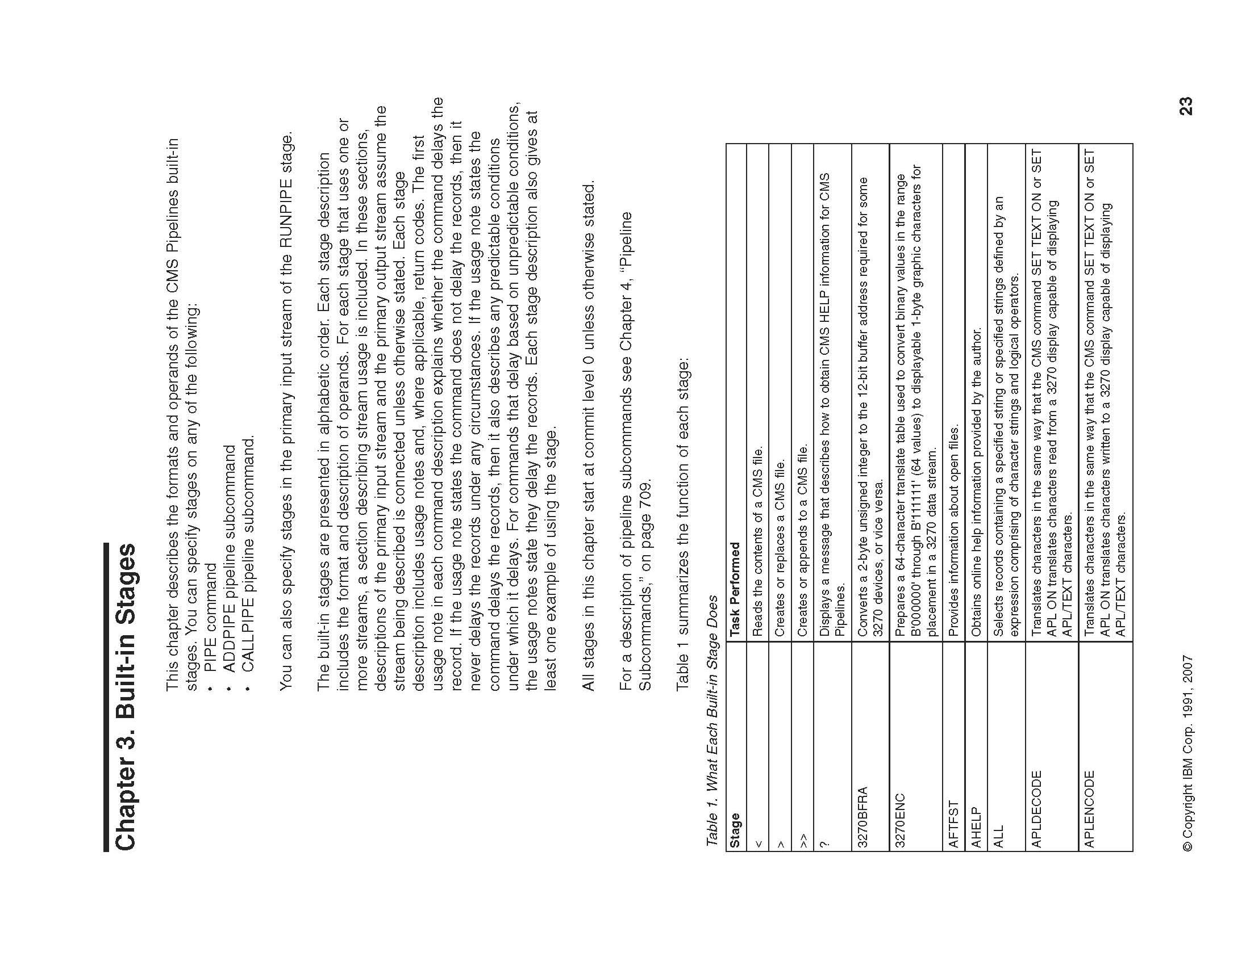

Slide 20
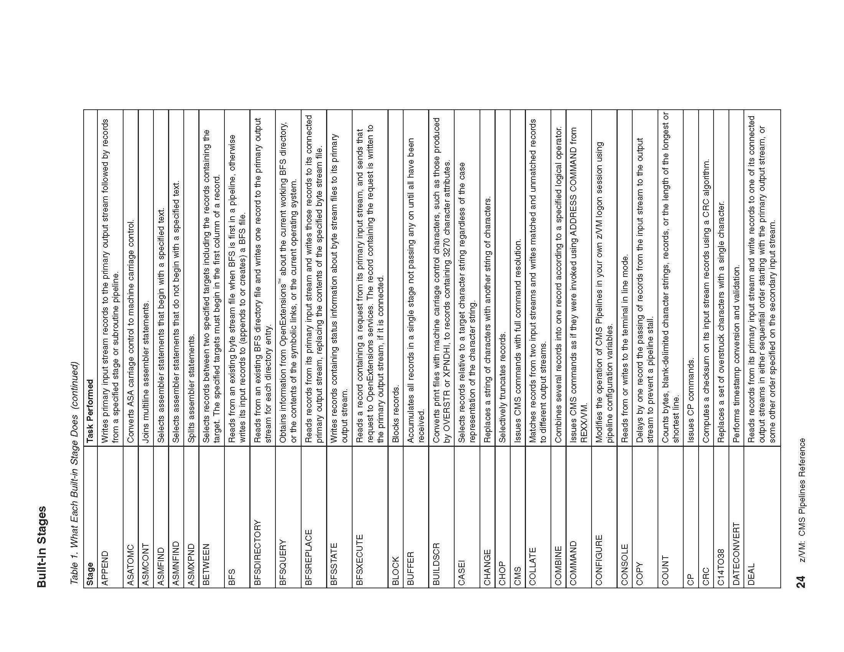

Slide 21
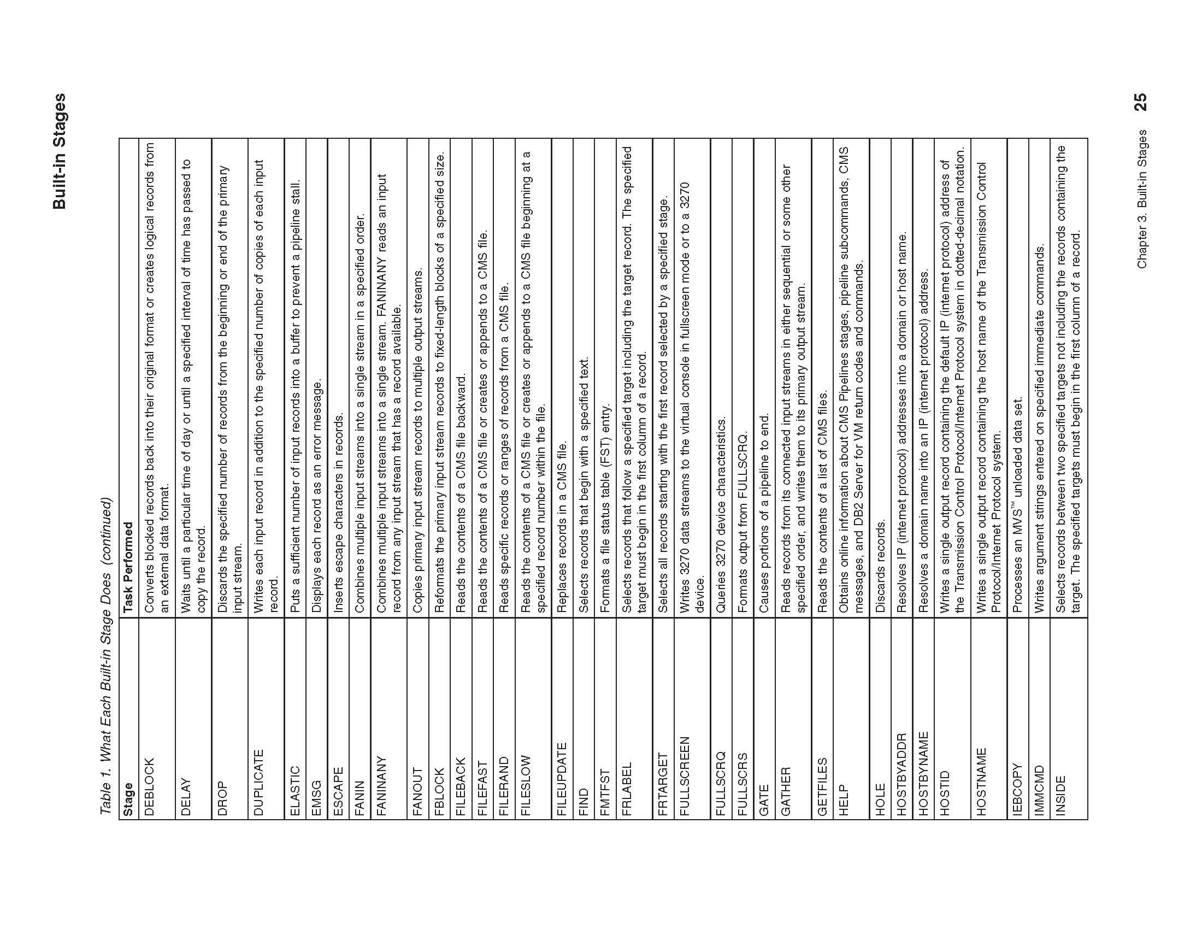

Slide 22
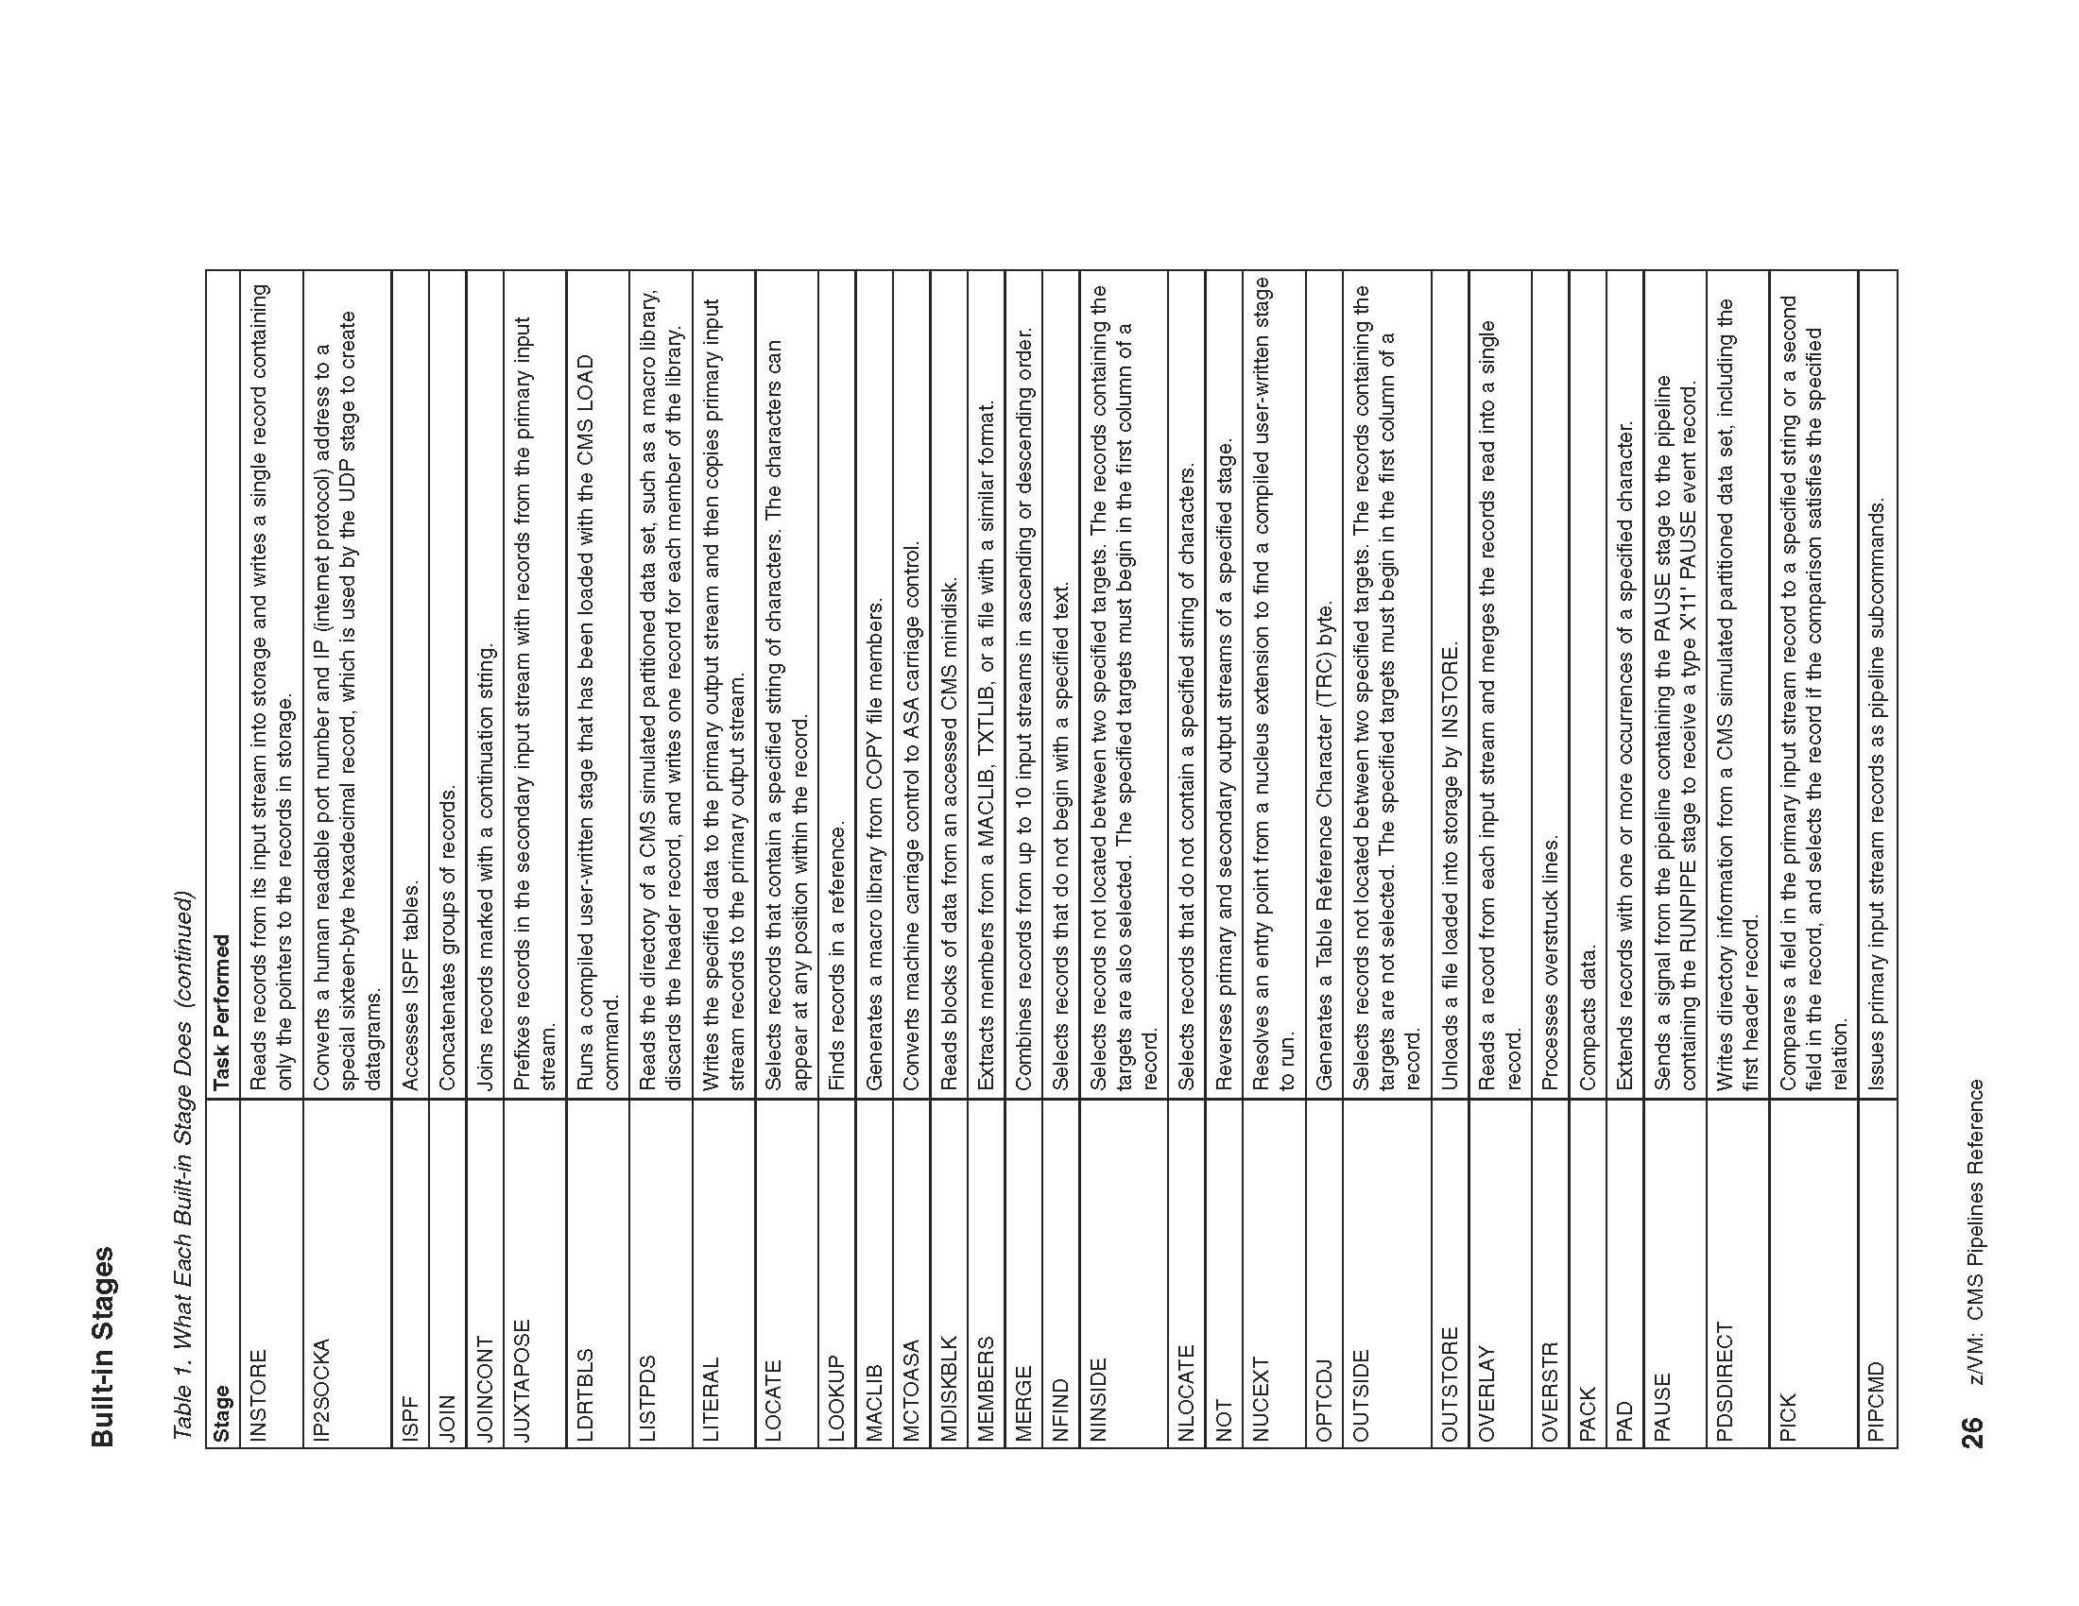

Slide 23
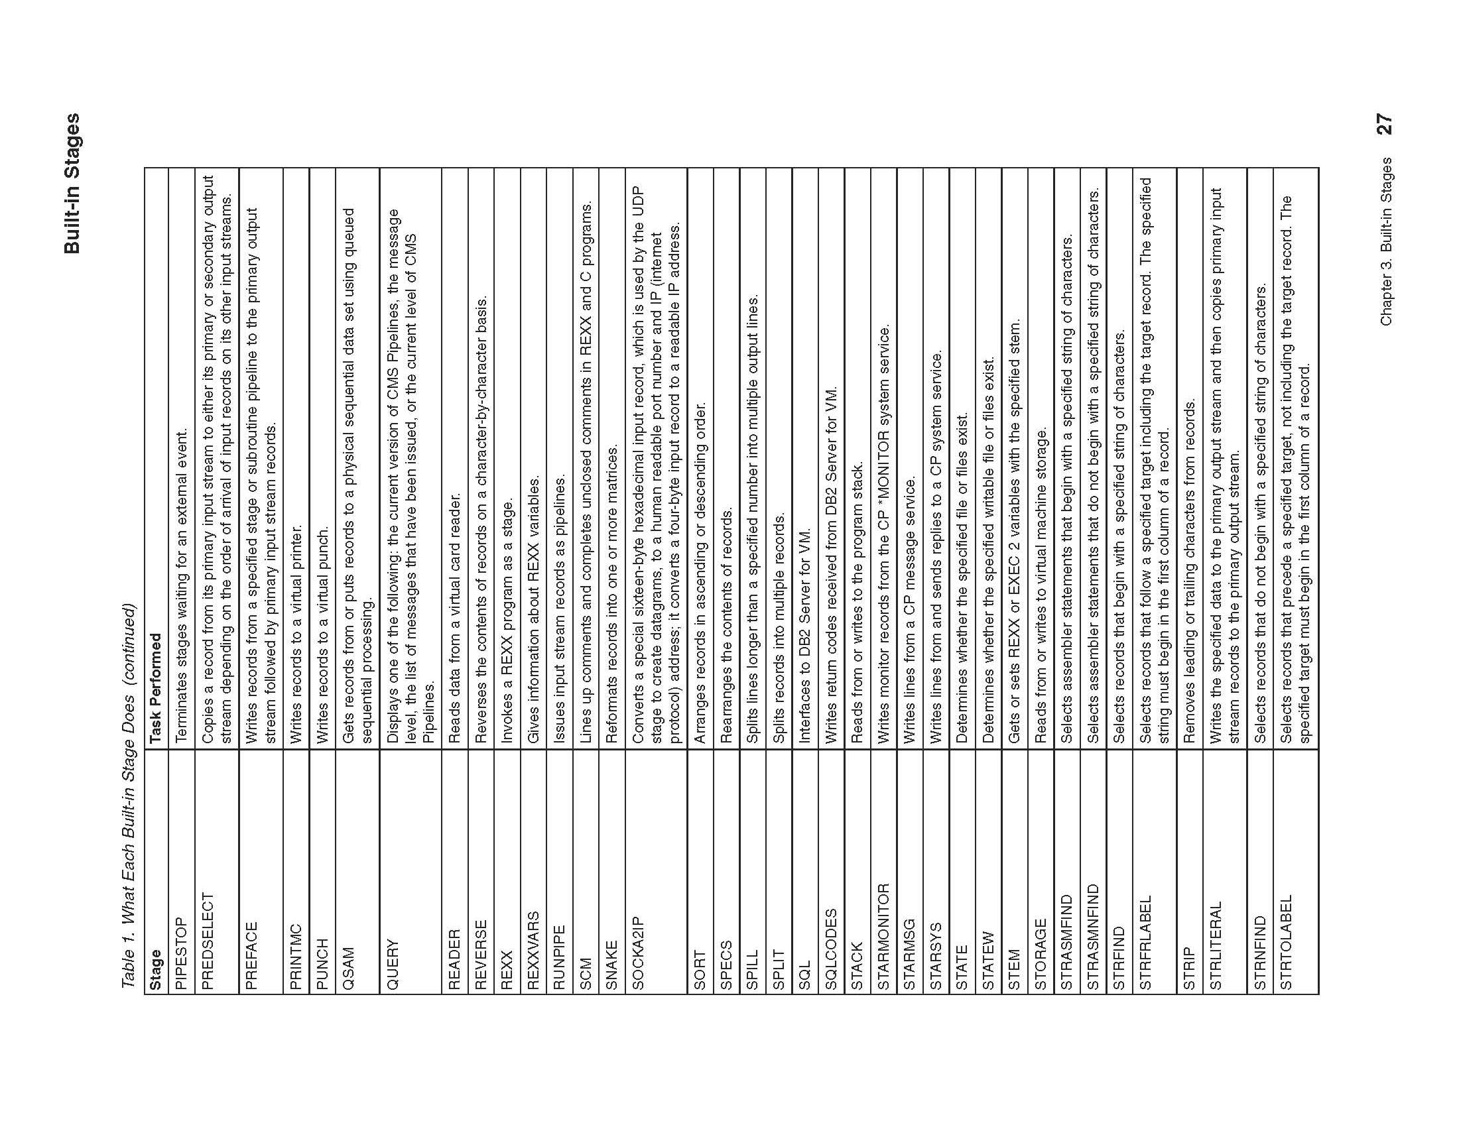

Slide 24
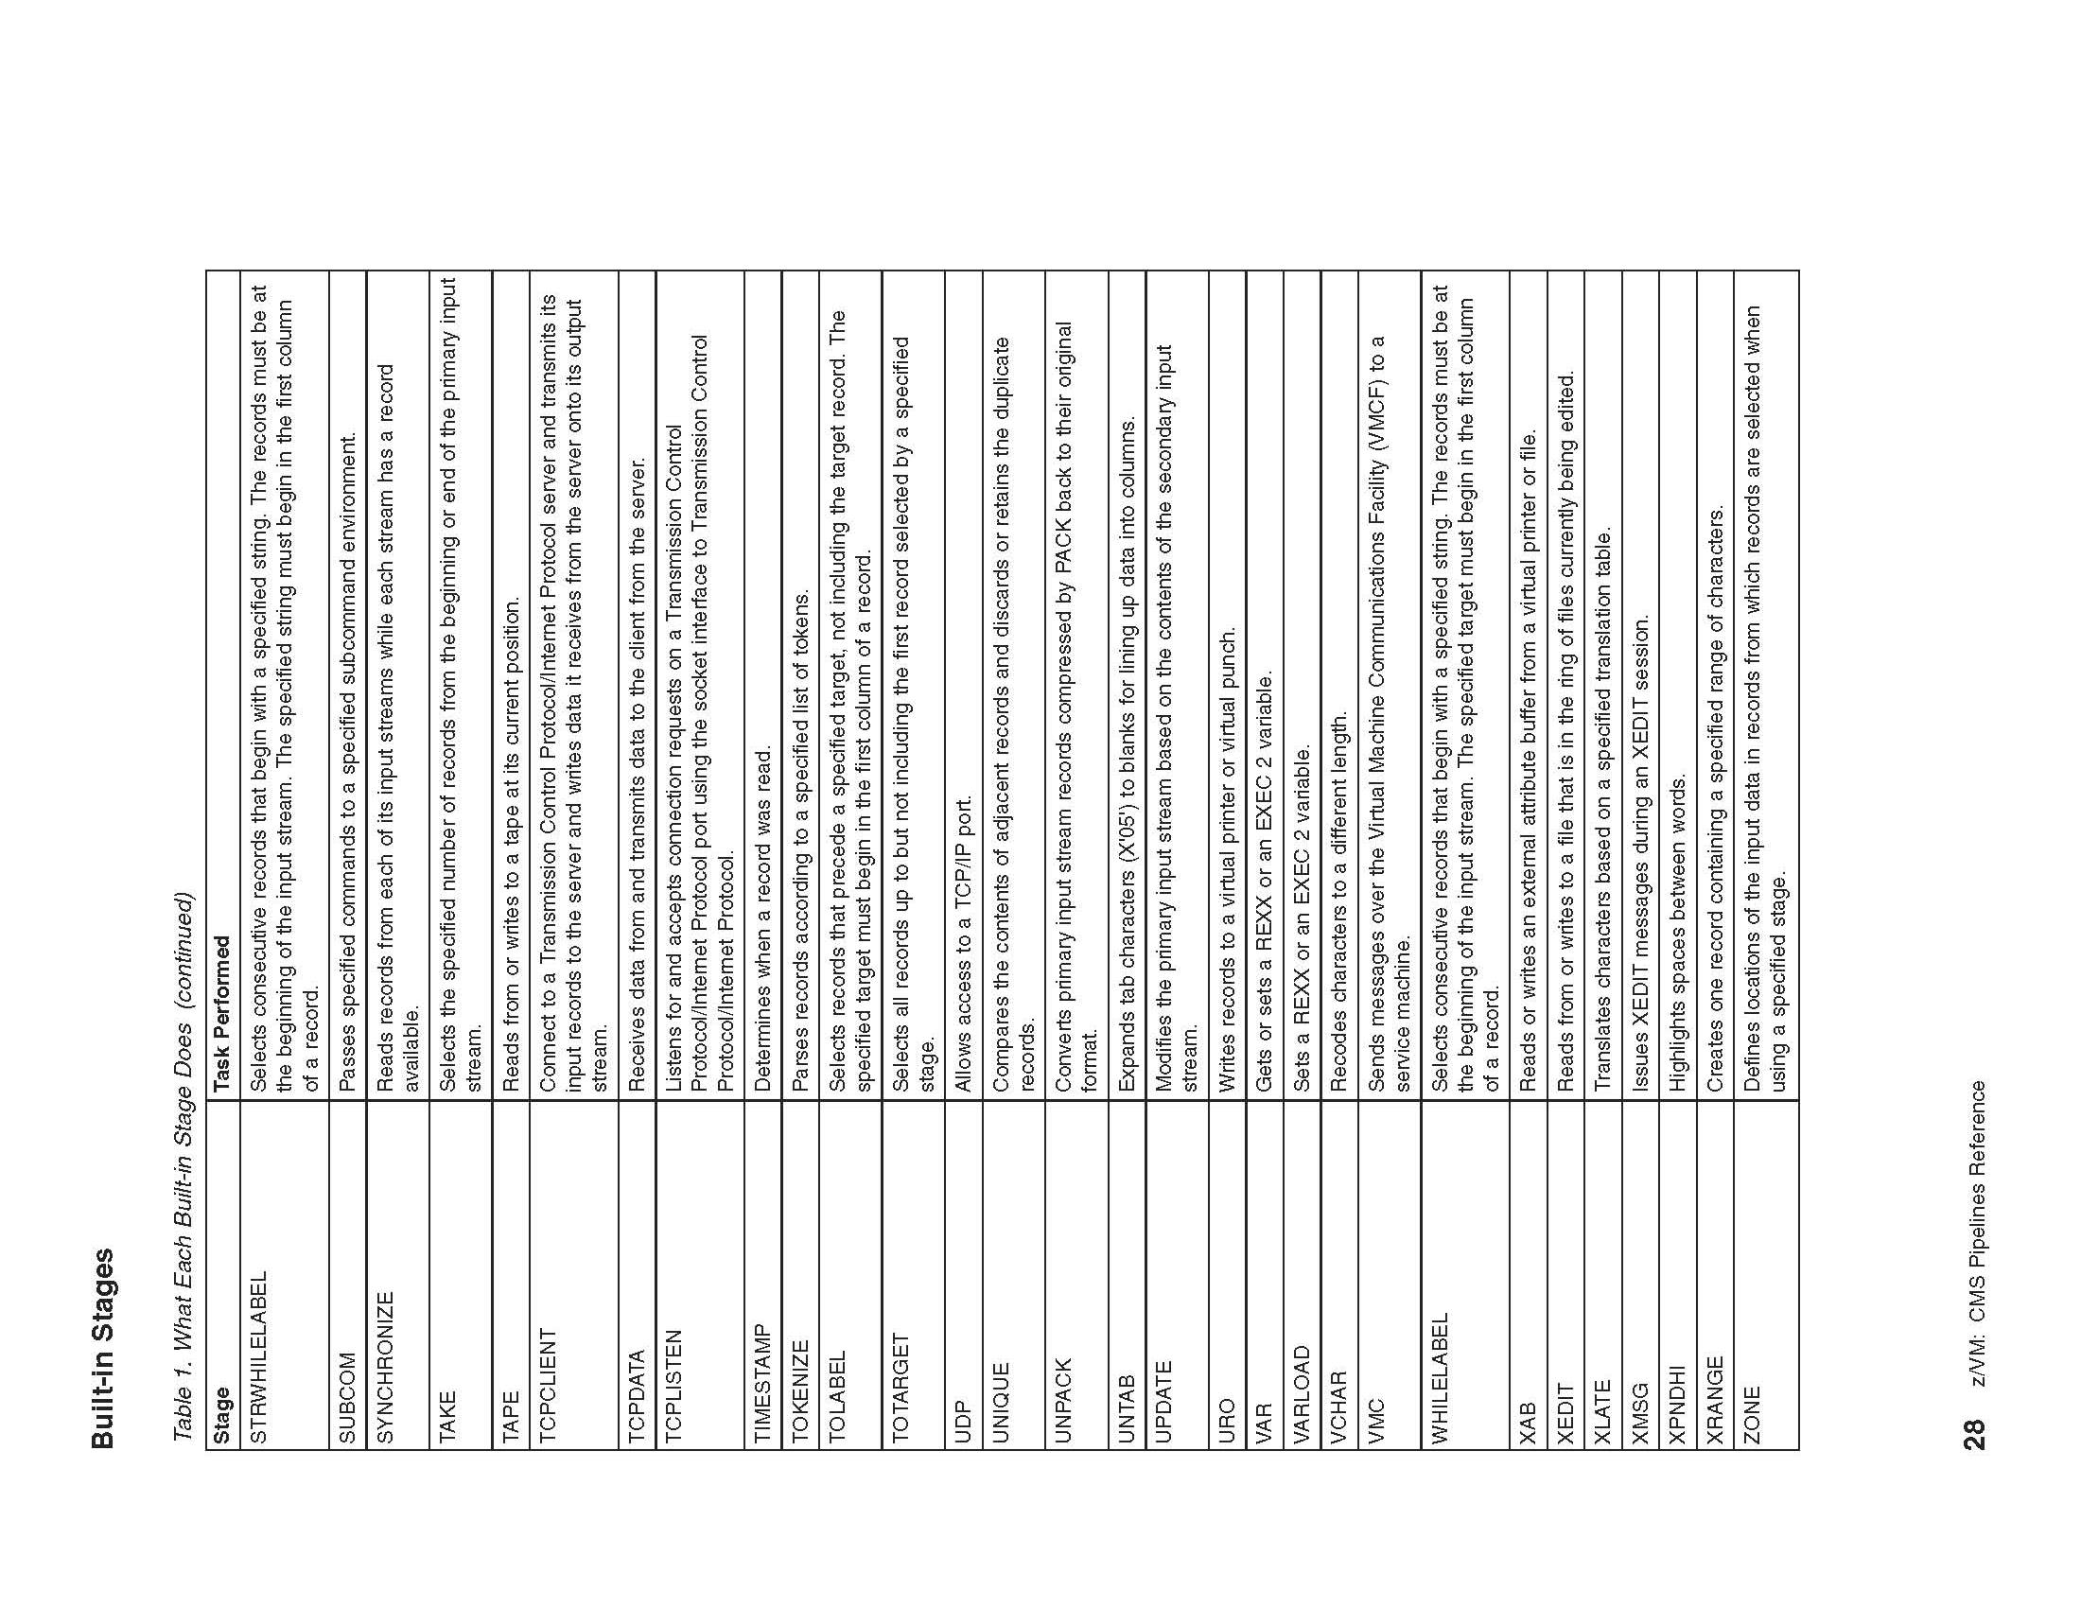

Slide 25
